Slide 1
Chapter 9
Integrating Audio and Video

Slide 2
Chapter Objectives
You will have mastered the material in this chapter when you can:
Describe the benefits and limitations of multimedia in websites
Identify audio formats
Identify video formats
Describe a plug-in
Understand codecs
Understand and create audio elements

Slide 3
Chapter Objectives (continued)
Understand and create video elements
Identify common audio attributes
Identify common video attributes
Understand the source element
Test audio elements
Test video elements
Make videos accessible

Slide 4
Introduction
A website provides several creative opportunities to capture the attention of your audience
Many websites use multimedia to enrich the user experience and provide interactivity
Digital media such as audio, video, and animation

Slide 5
Project — Add Audio and Video to a Webpage
Roadmap
Insert the audio element
Insert the video element
Style the video element
Make the video accessible

Slide 6
Using Multimedia
Multimedia: combination of text, images, sound, and video to express an idea or convey a message
Many websites use videos to publicize products, please visitors, or provide instruction
Podcasts: series of audio or video clips that are released in a sequence; popular in home, academic, and corporate settings

Slide 7
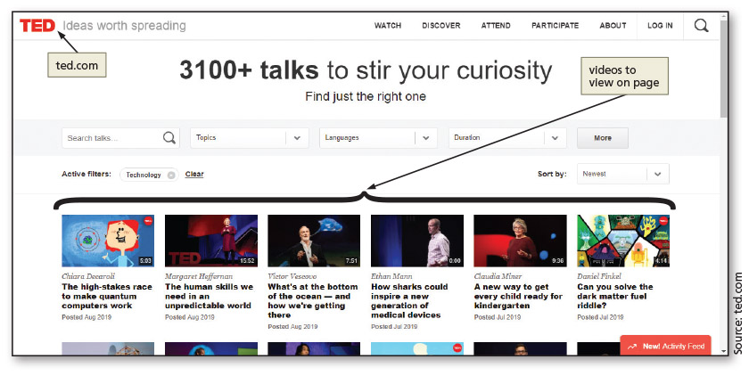
Using Multimedia (continued 1)
Figure 9-3

Slide 8
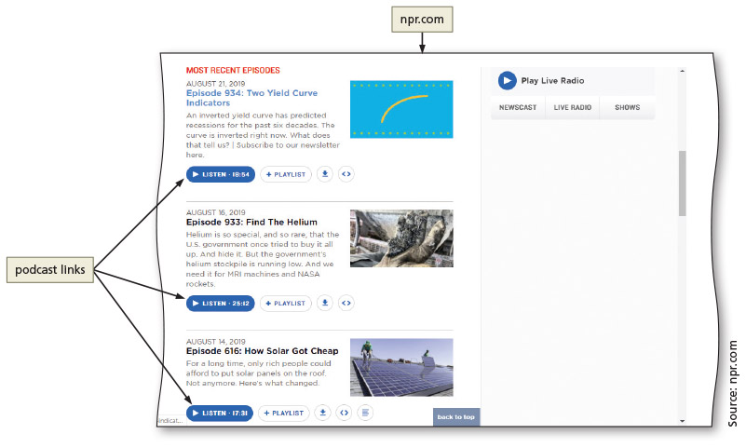
Using Multimedia (continued 2)
Figure 9–4

Slide 9
Creating Multimedia Files
One can obtain multimedia files by creating them or finding files that are already available
Methods of creating audio files
Microphone
Software designed to edit digital files, such as Audacity
Free, open-source audio editor
Adobe Audition

Slide 10
Creating Multimedia Files (continued 1)
Copyright and licensing requirements
Must be understood in order to use any portion of files that have been professionally developed
Methods of creating video files
Digital camcorder
Digital camera
Smartphone
Multimedia resources on the web are available free of copyright restrictions
Search for “public domain audio or video”

Slide 11
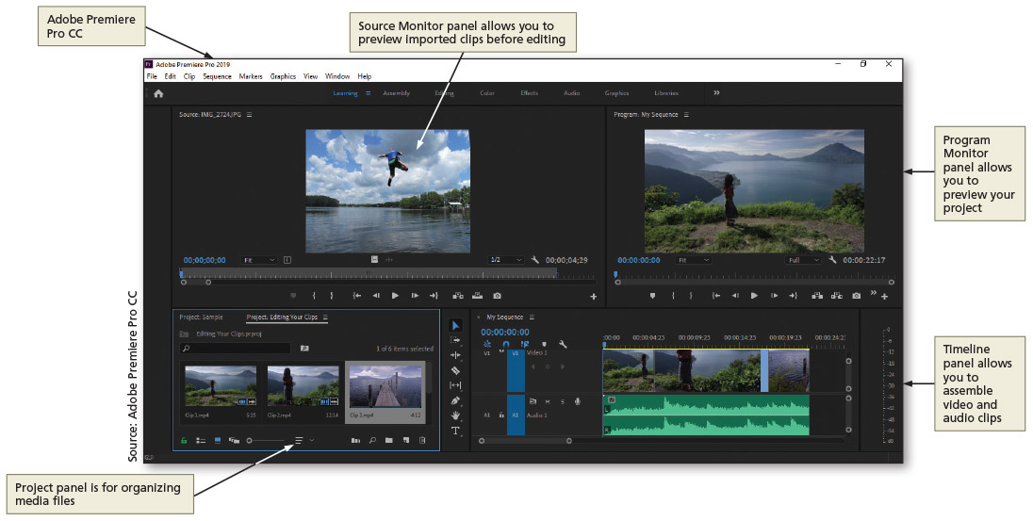
Creating Multimedia Files (continued 2)
Figure 9–6

Slide 12
Embedded vs. External Multimedia
Embedded multimedia
Embedding media is similar to inserting inline images
Media files appear within the webpage along with the audio or video player controls
Visitors use the controls to play or stop the media
External multimedia
Website visitors click a link to access external media files
Media is displayed out of context with the webpage that contains the link

Slide 13
Media Players and Plug-Ins
Media player: computer software that is used to play multimedia files
Browser extension (i.e., plug-in): extra software added to browsers (or other programs) to provide a capability that is not inherent to the browser

Slide 14
HTML 5 and Multimedia
Built-in media support was introduced in HTML 5 through the audio and video elements
Web developers can easily embed media into HTML documents using the audio and video elements

Slide 15
Flash
Flash, or Adobe Flash, has been used within websites for approximately 20 years
Can be used to create animations or movie files
Files require the browsers to have a Flash plug-in and end with the .swf file extension
Since the iOS operating system does not support flash, web developers have embraced JavaScript to incorporate additional interactivity within their websites

Slide 16
Java Applets
A small program created with Java, a programming language
If browsers have installed and enabled Java, Java applets can be embedded within a webpage
Use of Java applet in today’s modern websites has declined

Slide 17
Object Element
Used to embed multimedia objects
Flash Players, PDF readers, and Java applets
The param element is used to define parameters for plug-ins embedded with an object element

Slide 18
Object Element (continued)
Example of the object element:
<object data="audio.wav">
<param name="autoplay" value="true">
</object>
In this example, an audio file named audio.wav is embedded on the webpage
The autoplay parameter is set to true, meaning the audio starts playing when the webpage opens

Slide 19
Integrating Audio
Audio blended within a webpage should have a distinct purpose
Should provide added value or instruction
Time taken for a browser to load the audio file should also be considered
One popular way that websites use audio is to provide links to music files
Visitors can play or download

Slide 20
Audio File Formats
Three audio file formats supported by the HTML 5 audio element: .mp3, .ogg, and .wav
Audio converter software can be used to convert files from one audio format to a supported format
File compression techniques are used to reduce the size of the audio files for the web
Can also diminish sound quality

Slide 21
File Compression and Codecs
Codec: compression technology used to compress images, audio, and video files
Codec is short for code/decode because it consists of an encoder, which compresses the file, and a decoder, which decompresses the file
Although the page load time is improved using codecs, compressing a media file too much leads to loss of sound quality

Slide 22
HMTL 5 audio Element
The audio element is used to define sound, such as music or other audio streams
Browsers that do not support the audio element ignore the <audio> tag
Text content to alert users should be inserted between the <audio> and </audio> tags

Slide 23
Integrating Video
Video is used widely on today's websites
Powerful visual communication tool to capture attention
Identify the best uses for video, video file formats, encoding, the video element, and making videos accessible
Video should enhance, rather than distract from, websites

Slide 24
Video File Formats
Three video file formats are supported by the HTML 5 video element: mp4, .ogg, and .webm
Video converter software can be used to convert an unsupported video file format to a supported format

Slide 25
HTML 5 video Element
Three HTML elements can be used to incorporate videos in a webpage: embed, object, and video
The embed element is used to embed multimedia elements in HTML pages
Used to insert a plug-in, such as a Flash video

Slide 26
Using the video Element
Use the video element to specify a video, such as a movie clip or other video stream, on a webpage
Refer to Table 9–5 for attributes and values that can be used with the video element

Slide 27
Using the video Element (continued 1)
Text content should be inserted between the <video> and </video> tags
Browsers that do not support the video element ignore the <video> tag
Text content should be inserted to alert users

Slide 28
Using the video Element (continued 2)
Sample code used to insert the video element to a video file named advertisement.mp4 in a webpage
<video width="320" height="240" controls="controls">
<source src="advertisement.mp4" type="video/mp4">
<p>Your browser does not support the HTML5 video element.</p>
</video>
The code sets the video dimensions (320 pixels by 240 pixels) and displays playback controls

Slide 29
Using the video Element (continued 3)
Video File Format | Internet Explorer | Google Chrome | Mozilla Firefox | Apple Safari | Opera
MP4 | · | · | · | · | ·
Ogg |  | · | · |  | ·
WebM |  | · | · |  | ·
Table 9–6 Video File Browser Support

Slide 30
Making Videos Accessible
When a video includes someone speaking, include captions to make it accessible for deaf and hard of hearing users
Captions are text appearing over the bottom portion of a video

Slide 31
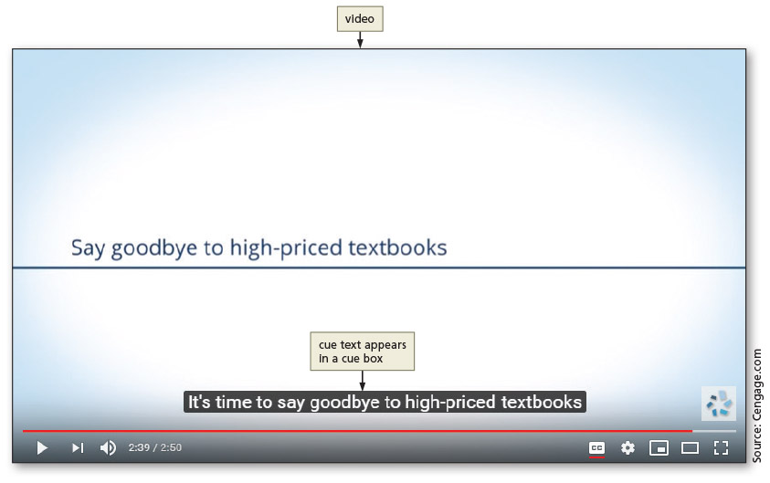
Making Videos Accessible (continued 1)
Figure 9–23

Slide 32
Making Videos Accessible (continued 2)
The caption text, also known as cue text, displays the words being spoken in the video or describes a sound in the video
Cue text appears within a cue box on the video

Slide 33
Making Videos Accessible (continued 3)
To create captions, use the WebVTT format
WebVTT, which stands for Web Video Text Track, is the W3C standard used to create captions for video content
The file is created with a text editor and saved with an extension of .vtt
HTML track element is used to insert the captions file within the webpage

Slide 34
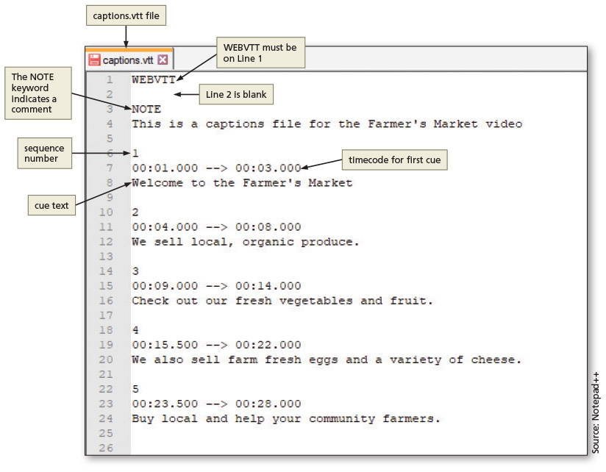
Making Videos Accessible (continued 4)
Figure 9–24

Slide 35
Chapter Summary
In this chapter, you learned how to:
Integrate audio and video elements within a website
Use the HTML 5 audio element to insert audio source elements and specify that it automatically plays and displays controls
Use the HTML 5 video element and insert a video onto a webpage and code for crossbrowser compatibility
Use CSS styles to format a video for all viewports
Make a video accessible to all visitors and test the video in a web server

